Slide 1
Gynecologic side effects of tamoxifen
Panel disscussion Dec 2021
Nahid Sedighi
Leila sadeghi
Azadeh yousefnejad
Ramesh Omranipour (Director)

Slide 2
ER antagonist in breast cancer
in the endometrium, TMX has ER agonist activity that is able to stimulate proliferation, causing an increased risk of uterine pathologies, including
typical and atypical glandular hyperplasia,
endometrial polyps,
uterine fibroids, adenocarcinoma and sarcoma

Slide 3
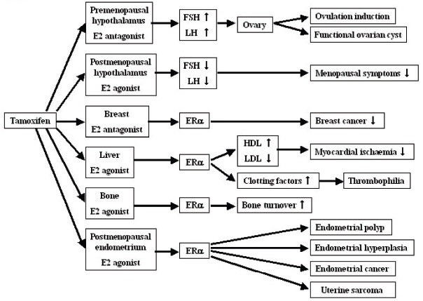
Figure 2. Pleiotropic effects of tamoxifen pointing to organ-specific beneficial or deleterious effects.
Article Copyright © 2008 Authors, Source DOI: 10.4137/CPath.S487. See content reuse guidelines at: sagepub.com/journals-permissions

Slide 4
Endometrial Benign pathologies
Several studies have documented a connection between TMX therapy and endometrial polyps and hyperplastic endometrial changes.
Their incidence exceeds by 3 (NSAB B14:1994) , 9 ( Stockholm BCSG 1995) and 10 times (Neven 2000) the incidence of endometrial cancer in TMX-treated patients.
the majority of the proliferative effects of TMX on endometrium are unlikely to progress to cancer.

Slide 5
Risk factor of Endometrial cancer
Independently of TMX use, postmenopausal breast cancer patients have a 20% prevalence of endometrial proliferative disorders—including hyperplasia, polyps, atypical hyperplasia (2%), and even EC (0.6%)
The highest risk: postmenopausal women with higher body mass and endometrial pathology before TMX treatment the risk for premenopausal women is very low

Slide 6
How to screen females with breast cancer for abnormal endometrial proliferation
TVUS
Sonohystrography
Hystroscopy &biopsy
What is the thereshold thickness for furthur investigation ?
Discrepancy between thickness in TVUS & hystroscopy- biopsy?
Duration of TMX therapy & severity of endometrial pathology?

Slide 7
The effects of tamoxifen on the female genital tract
Dr Azadeh yousefnezhad
Assistant professor of TUMS

Slide 8
Tamoxifen is a selective estrogen receptor modulator (SERM) that is widely used in the treatment of patients with breast cancer and for chemoprophylaxis in high risk women
results in a spectrum of abnormalities involving the genital tract, the most significant being an increased incidence of endometrial cancer and uterine sarcoma.
reported a significant increase in the mean endometrial thickness after 3 years of tamoxifen administration.

Slide 9
Endometrial polyps
incidence in women treated with tamoxifen is between 8 and 36% versus 0–10% in untreated women
They tend to be larger with a mean diameter of 5 cm versus 0.5–3.0 cm in the general population
Tamoxifen-related polyps are reported to have an increased rate of malignant change ranging from 3 to 10.7% compared with 0.48% in the general population

Slide 10
Endometrial hyperplasia
The incidence of endometrial hyperplasia in postmenopausal women with breast cancer treated with tamoxifen is increased
he incidence is 1.3–20% in these patients, compared to the 0–10% incidence in postmenoausal breast cancer patients who are not receiving tamoxifen
in patients with atypical hyperplasia, 23% progress to carcinoma, whereas in patients without atypia, only 2% progress to carcinoma

Slide 11
Endometrial carcinoma
1.3–7.5-fold increase in the relative risk of developing endometrial cancer with data from major clinical studies indicating tamoxifen use results in an approximately twofold increase in the incidence rate of endometrial cancer
he risk of developing endometrial cancer increases with duration of treatment and cumulative tamoxifen dose as well as prior estrogen replacement therapy, obesity, and the presence of pre-existing endometrial pathologic conditions
Many studies found that most cases of endometrial cancers occurring in tamoxifen-treated patients were of low grade and stage, with no differences in stage, grade, or histologic subtype compared to non-treated patients.However, other studies have found endometrial cancers in postmenopausal patients treated with tamoxifen to be more advanced with poorer prognoses than in non-treated patients. Additionally, these studies have shown an increase in unfavorable histologies including carcinosarcoma, adenosarcoma and Mullerian mixed tumors, resulting in more advanced stage at diagnosis and worse survival. In light of these findings, additional studies may be warranted to determine if there may be a benefit to screening asymptomatic women treated with tamoxifen.

Slide 12
Endometrial cystic atrophy/adenomyosis
edometrial cystic atrophy is diagnosed histologically when multiple cystic spaces lined by atrophic endometrium are present within a dense fibrous stroma.At hysteroscopy, endometrial cystic atrophy is described as smooth, white, hypervascularized, and atrophic, with scattered protuberances. ‘Tamoxifen mucosa’ differs from the atrophic mucosa in postmenpausal women who are not treated with tamoxifen as their mucosa is characterized as pale, thin, and without protuberances
The incidence of adenomyosis is increased 3–4 times in women treated with tamoxifen than in the general population
the cysts seen in women treated with tamoxifen do not appear to be premalignant.

Slide 13
Leiomyomas
Estrogen receptors are located both in the endometrium and uterine stroma. Several studies have demonstrated a growth of uterine fibroids in postmenopausal patients treated with tamoxifen.
However, the leiomyomas in women treated with tamoxifen do not appear to differ histologically from those in untreated women

Slide 14
Effect of tamoxifen on the ovaries
tamoxifen was initially synthesized as a contraceptive in the 1960s but was found to induce ovulation in anovulatory infertile women in 1971
tamoxifen induces estrogen production in the premenopausal ovary without a significant subsequent rise in FSH and LH
Pre- and postmenopausal women treated with tamoxifen have an increased risk of developing ovarian cysts. Asymptomatic unilocular cysts in these patients should be followed conservatively and discontinuation of tamoxifen usually leads to the reduction and disappearance of these cysts
Of particular concern is the negative effect of tamoxifen-induced ovulation and the risk of ovarian carcinoma in patients with BRCA1 and BRCA2 gene mutations. Annual sonographic monitoring of the ovaries in this population has been recommended although its efficacy is still unproven

Slide 15
Effect of tamoxifen on the cervix
Tamoxifen has estrogen agonist effects on the cervix of postmenopausal women. In one study, 89% of tamoxifen-treated postmenopausal breast cancer patients developed estrogenized cervical smears rather than atrophic smears.
Women treated with tamoxifen have a higher incidence of benign reactive atypia or atypical squamous cells of undetermined significance, without an increase in dysplasia or cervical cancer[

Slide 16
Effect of tamoxifen on the vagina
tamoxifen has been shown to have both estrogen agonist and antagonist effects on the vaginal epithelium.
In one study, an estrogen agonist effect was seen on the vaginal smears in 34 of 49 postmenopausal breast cancer patients treated with tamoxifen and was more common in older patients.
Another study showed that there appears to be an anti-estrogenic effect of tamoxifen on the vaginal epithelium in an estrogen-rich environment. The maturation index is a measure of hormonal stimulation on the endometrium and is used to describe the estrogenic status of the vaginal epithelium. When postmenopausal breast cancer patients were primed with estradiol valerate to provide them with an estrogen-rich vaginal epithelium prior to the administration of tamoxifen, the maturation index and estrogenic status of the vaginal epithelium was found to decrease.
Despite its mechanism of action, vaginal dryness and dyspareunia have been reported in both pre- and postmenopausal patients treated with tamoxifen.

Slide 17
Imaging review

Slide 18
Endovaginal ultrasound
the normal postmenopausal endometrium appears as a single echogenic line and should not exceed 5 mm as a bilayer thickness
Most women undergoing tamoxifen treatment have a thicker endometrium compared with control subjects (9–13 mm versus 4.0–5.4 mm)
In postmenopausal women undergoing estrogen replacement therapy, the normal endometrium may measure up to 8 mm in thickness.

Slide 19
endometrial thickness threshold
the upper limit for normal endometrial thickness on transvaginal US in asymptomatic women receiving tamoxifen remains controversial.
Various authors have recommended endometrial thickness cut-off values ranging from 4 to 10 mm with sensitivity of positive histologic findings ranging from 85 to 100% and specificity ranging from 56 to 96%^{[12,63,65–69]}.
Increased endometrial thickness correlates with increased incidence of endometrial pathology
However, positive histologic findings, such as endometrial proliferation and simple hyperplasia, may be clinically unimportant. Additionally, a thicker endometrium on the US image does not necessarily correlate with specific pathologic endometrial findings

Slide 20
Hysterosonography
Hysterosonography has increasingly been used to improve the ability to diagnose intrauterine pathologic conditions and to resolve discrepancies between endometrial thickening on transvaginal US images and insufficient material or non-diagnostic results at endometrial biopsy
Hysterosonography is an attractive adjunct to transvaginal US because it more clearly defines endoluminal lesions that are pedunculated or sessile and can be used to better determine whether an abnormality is endometrial or subendometrial

Slide 21
The authors concluded that hysterosonography has high sensitivity (100%) and a high positive predictive value (95.5%) in patients receiving tamoxifen who have an endometrial thickness of more than 8 mm at transvaginal US
In a retrospective study of 51 patients treated with tamoxifen, Hann found a significantly higher sensitivity of hysterosonography (100%) versus endometrial biopsy (4%) for the diagnosis of endometrial polyps. She concluded that sonohysterography should be considered for evaluation of abnormal uterine bleeding or thickened endometrium on ultrasound even if endometrial biopsy results are negative

Slide 22
At hysterosonography, polyps appear as smoothly marginated echogenic masses with or without cystic areas. Polyps often have a narrow attachment to the endometrium but may be broad-based .
Submucosal fibroids appear as round structures arising from the myometrium, commonly with wide attachment to the myometrium, although they are occasionally pedunculated.
Hysterosonographic features of adenomyosis include small cysts which appear in the inner myometrium.
Diffuse smooth thickening of the endometrium suggests hyperplasia, however, hyperplasia may also appears as irregular asymmetric endometrial thickening.
An irregular heterogenous mass or irregular focal thickening of the endometrium is suggestive of endometrial carcinoma

Slide 23
MR imaging
R imaging can demonstrate both endometrial and myometrial pathologic conditions. MR imaging may be appropriate in patients with an equivocal or abnormal endovaginal US who are unable to undergo hysterosonography due to cervical stenosis and at centers that do not offer hysterosonography

Slide 24
According to the American College of Obstetricians and Gynecologists:
just taking tamoxifen is not a reason to perform endometrial sampling or routine ultrasonography.
In premenopausal women taking tamoxifen who present with abnormal uterine bleeding, transvaginal ultrasonography (TVUS) is recommended.
If the ETis ≤ 4 mm, there is no need for endometrial sampling, and the routine follow-up is recommended. Endometrial biopsy is contingent on the continuation of abnormal uterine bleeding. If endometrial thickening is present in TVUS, then hysteroscopy or saline infusion sonohysterography is recommended. In this group of patients, if endometrial biopsy confirms hyperplasia, it is recommended that tamoxifen be discontinued and cyclic progestin therapy be initiated.
In the case of no desire for fertility, hysterectomy may be an option.
Some other experts recommend that for premenopusal women, taking tamoxifen, irregular vaginal bleeding should be evaluated by hysteroscopy, uterine ultrasonography and if remains ulcer biopsy should be done. In postmenopausal women treated with tamoxifen, any vaginal bleeding should be pursued with biopsy and close follow-up.
Postmenopausal women using tamoxifen with abnormal vaginal bleeding who have endometrial hyperplasia (especially atypical form) are candidates for hysterectomy. Moreover, evidence recommends dividing postmenopausal women into low- and high- risk groups for developing atypical hyperplasia based on the presence of benign endometrial polyps before therapy.24 In this case, pretreatment screening with TVUS is recommended.19

Slide 25
There are no evidence-based recommendations for uterine malignancy screening for patients on tamoxifen. Current recommendations are annual gynecologic examination and evaluation of any abnormal vaginal bleeding.2 0 The value of transvaginal ultrasound in asymptomatic patients on limited tamoxifen treatment (less than 5 years) is unproven. The abnormal endometrial thickness > 9 mm is acceptable in the studies, but further invasive investigations, such as dilation and curettage (D&C), are not recommended in the absence of vaginal bleeding.2 5 Some studies recommend using hysteroscopic biopsy because D&C does not seem accurate enough to detect intrauterine pathologies in patients on tamoxifen.26 New methods of screening are also introduced. Elastosonography, which measures endometrial tissue strain, was recently used to assess the endometrium in patients on tamoxifen.27 Also, MRI can be used to assess endometrium and myometrium and their related pathologies when the TVUS findings are equivocal and hysterosonography is not possible to perform.

Slide 26
NORMAL ENDOMETRIUM

Slide 27
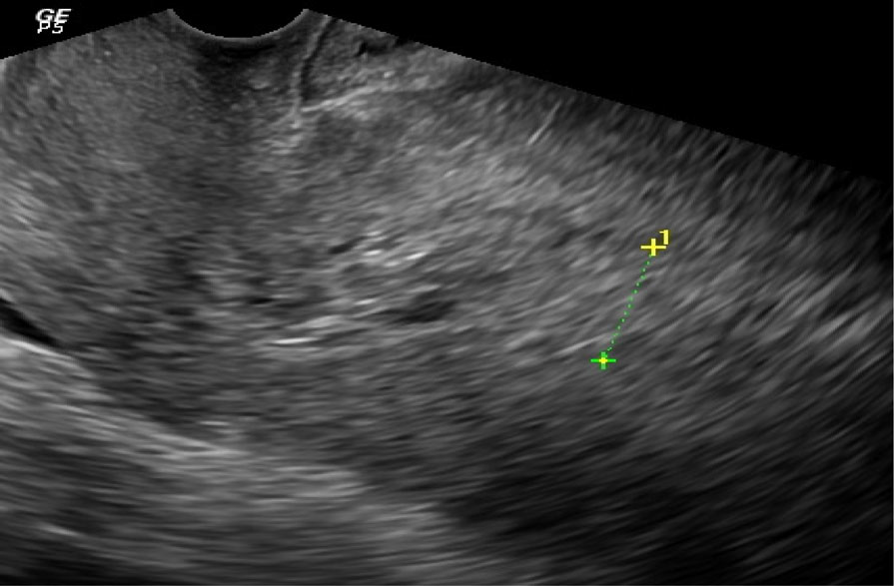
endometrial cystic atrophy

Slide 28
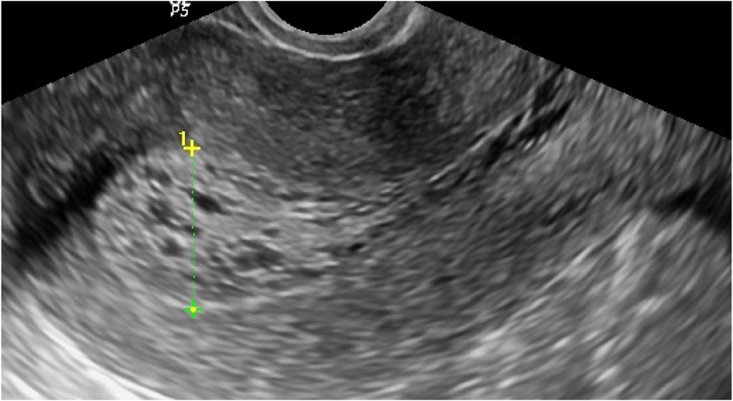
Histopathology
result of the endometrial biopsy was consistent with
endometrial hyperplasia

Slide 29
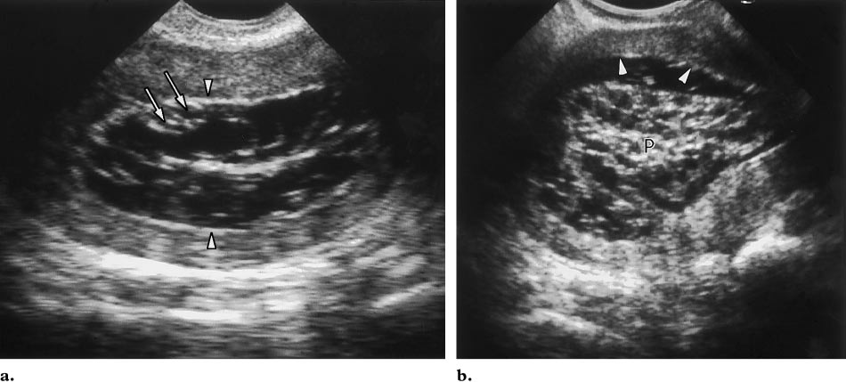
Tamoxifen-associated endometrial lesion.
Subsequent sonohysterogram clearly shows a focal polypoid lesion containing multiple cysts (P).
The remainder of the endometrium was normal in thickness (arrowheads). Pathologic analysis revealed an endometrial polyp.

Slide 30
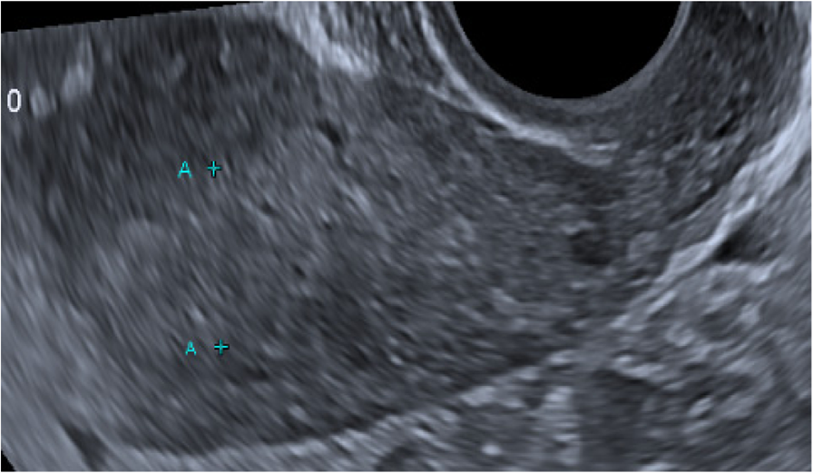
endometrial carcinoma

Slide 31
The guidelines for monitoring that reduce the
number of invasive sampling are as following:
-start with pretreatment uterine assessment using: transvaginal sonography or outpatient hysteroscopy. In
the absence of pretreatment endometrial pathology,
asymptomatic long term Tamoxifen users are
followed up on a yearly basis starting after 2 to 3
years of treatment because of the effect of cumulative doses.
Hysteroscopy or saline infusion sonography
will be required, if there is endometrial thickening.

Slide 32
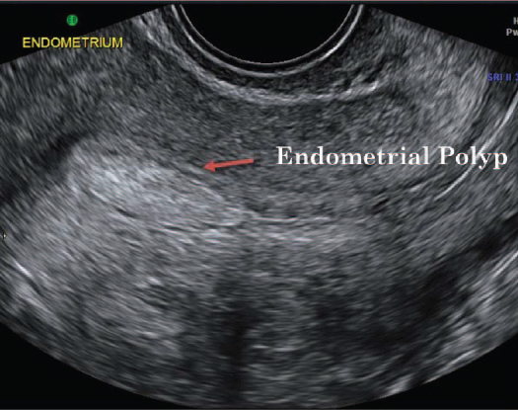
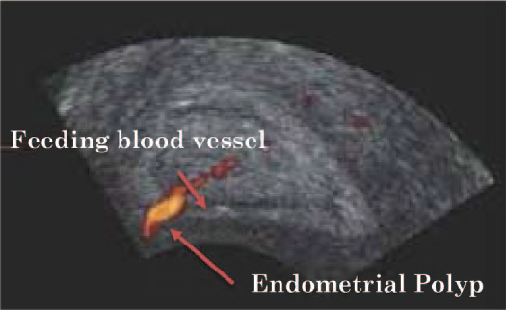

Slide 33
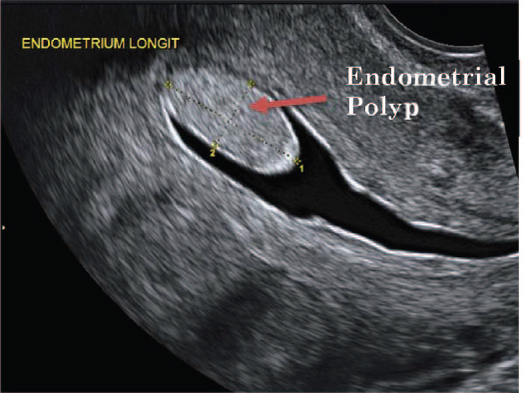
Saline infusion sonography (SIS) or Sonohysterography
(SHG) ultrasound image showing an endometrial polyp.

Slide 34
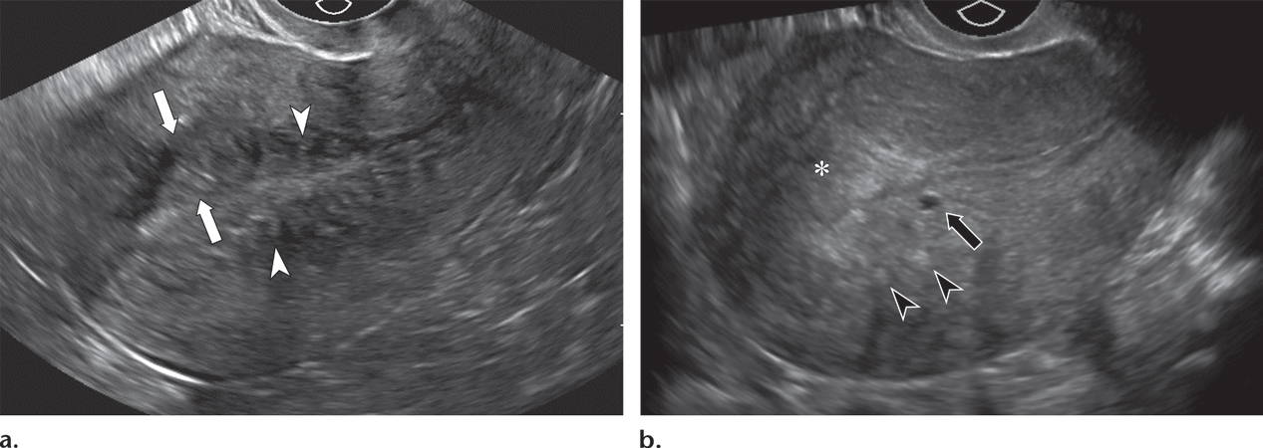
adenomyosis

Slide 35
Ultrasound images of a female patient, aged 60 years with thickened endometrium (confirmed to be typical endometrial
hyperplasia by pathological examination). B-mode ultrasound image, Power Doppler image and TV elastogram show
endometrial thickness =12 mm with no significant increase vascularity, green to light blue color and SR = 1.3.

Slide 36
Ultrasound images of a female patient, aged 55 years with malignant thickened endometrium (confirmed to be endometrial
adenocarcinoma by pathological examination). B-mode ultrasound image, Power Doppler image) and TV elastogram) show
endometrial thickness = 18 mm with increase vascularity, dark blue color and SR = 11.54.

Slide 37
THERE IS LITTLE IN LITERATURE ABOUT THE USE OF MRI IN THESE WOMEN

Slide 38
ENDOMETRIAL POLYPS

Slide 39
ADENOMYOSIS & POLYP

Slide 40
Routine Endometrial Surveillance on TMX
Fleming et al. Br J Surg 2018 systematic review ( 4 trials: 926 patients) to detect one case of EC in women on TMX, 332 TVUS & 56 endometrial biopsies had to be performed .
All the patients with endometrial malignancy had vaginal bleeding and were postmenopausal
routine TVUS for asymptomatic women on tamoxifen is not recommended.

Slide 41
Importance of symptoms
Lee et al :clin oncol 2001 284 premenopausal patients on TMX
Hysteroscopic evaluation and biopsy : if thickness>10mm,new polyp in TVUS, vaginal bleeding
Atypical endometrial hyperplasia in seven patients (2.5%), EC in five patients (1.8%), Endometrial polyps in 114 women (40.1%)
All the patients with EC and five of the seven patients (71%) with atypical endometrial hyperplasia had vaginal bleeding

Slide 42
Difference in EC between TMX users & nonuser
Bland et al. [Gyn Oncol 2009] association of 5 yrs TMX with high-risk uterine histological subtypes (Grade 3 endometrioid, serous, or clear cell EC)
Ngo et al. [EJSO 2014] more carcinosarcomas , worse prognosis for EC in br ca treated by TMX
Pierce et al. [Gyn Oncol 2017] no difference in progression-free (PFS) or overall survival (OS) between women with serous EC with or without preceding breast cancer or tamoxifen exposure

Slide 43
Approach to thick endometrium under TMX
Outpatient bx
D&C
Hold TMX without switch to AI
Switch to AI

Slide 44
Effect of TMX on Ovaries
induces estrogen production in the premenopausal ovary, FSH and LH do not rise or do so only slightly.( a direct effect on the ovaries of premenopausal women or at least an effect that is not through the classical route of the hypothalamic–pituitary–ovarian axis)
Ovarian cysts is reported 15,17% or up to 40% in premenopause
Surgical intervention is not required
Functional asymptomatic cysts should be followed conservatively

Slide 45
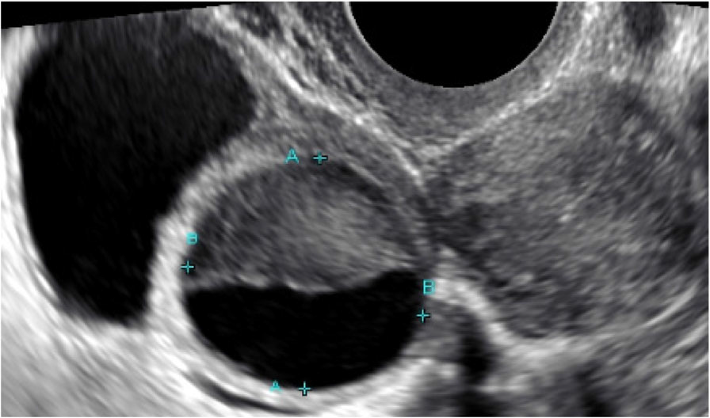
TVUS showing adnexal cysts (simple and complicated)

Slide 46
Management of Vasomotor symptoms
Pharmacologic treatment : SSRI,SNRI,anticonvulsants ( gabapantin, pregabalin)
In a trial 4wk venlafaxine (75mg/d) vs gabapantine (900mg/d) both reduce hot flush score 66% but most patients preferred venlafaxine (more nausea,appetite loss ,constipation in venlafaxine vs dizziness in gabapantine)
Nonpharmacologic therapy: CBT, hypnosis, acupuncture, weight control, SGB

Slide 47
Management of sexual side effects of TMX
Vaginal suppository , moisturizers(2/wk)
water or silicone based vaginal lubricants (before intercourse)
Lidocaine, laser therapy (if dyspareunia)
vit E
pelvic floor relaxation exercise
continue sexual activities
Although no studies have shown that using estradiol vaginal therapy is more likely to lead to breast cancer recurrence, many oncologists are reluctant to advise women to use vaginal oestrogen after breast cancer

